Slide 1
Optical Mark Recognition
Group Members :
Faiez Malik i19-2194
Syed Abu Bakr i19-2199

Slide 2
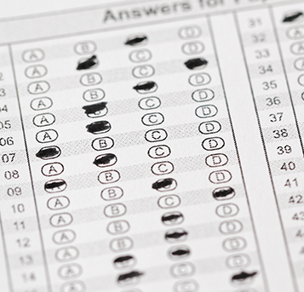
Introduction
OMR is the process of reading information that people mark on multiple choice examination papers in the form of shaded areas.
The use of OMR is not limited to schools; businesses and health care agencies use OMR to streamline their data input processes and reduce input error
All OMR techniques involve a device such as a scanner that takes an input from a predefined bubble sheet and does some processing on it. The processing part can differ from one technique to another

Slide 3
Motivation
Multiple Choice Question examinations used to be checked manually. Doing so would require manpower to manually look at each and every answer and compare it to an answer key
To make this task quicker and less error prone, we realized that we could use computers to check the answer sheets for us, compare it to an answer key and then log the records to a database.
3 steps that had been done manually would now be automated and done by the computer for us.

Slide 4
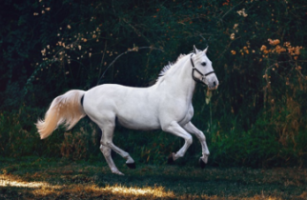

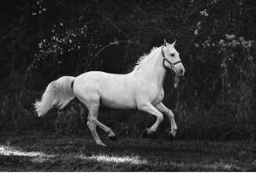
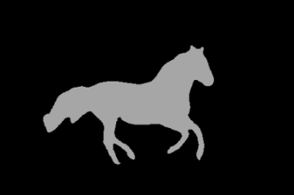
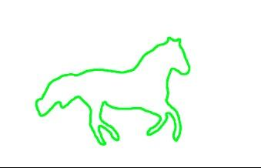
DIP topics that are to be used
Image Segmentation
Grayscale conversion
Canny edge detection
Thresholding
Transformation
Image contours detection

Slide 5
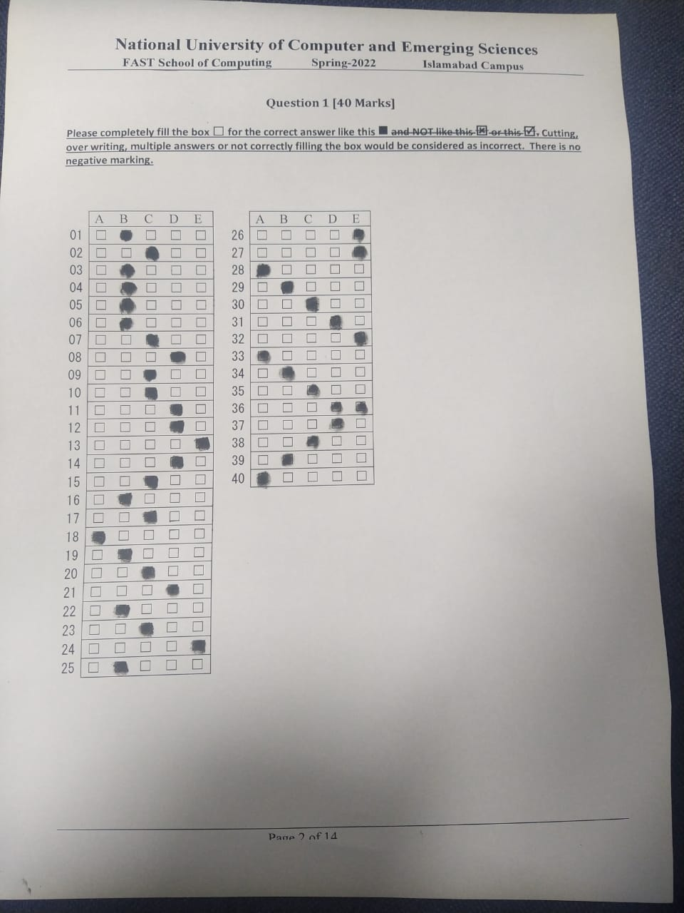
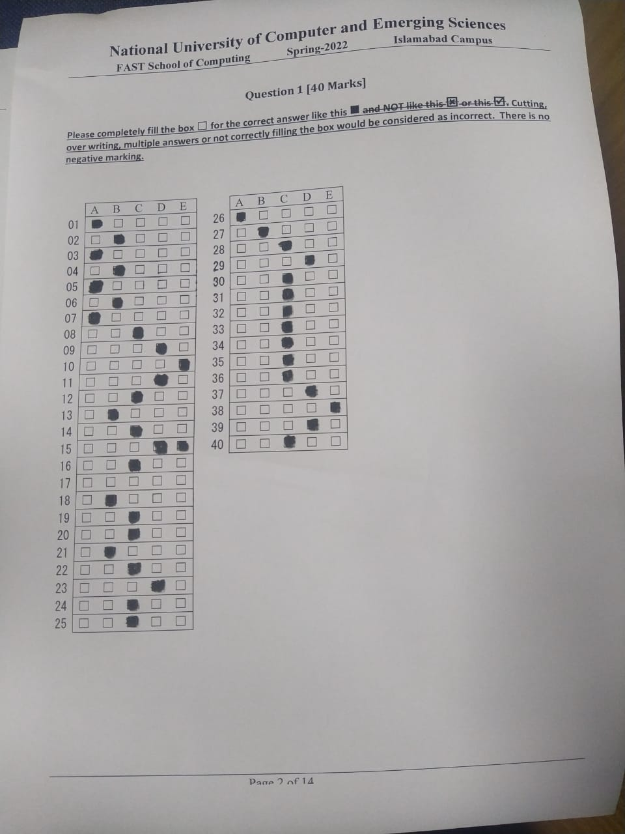
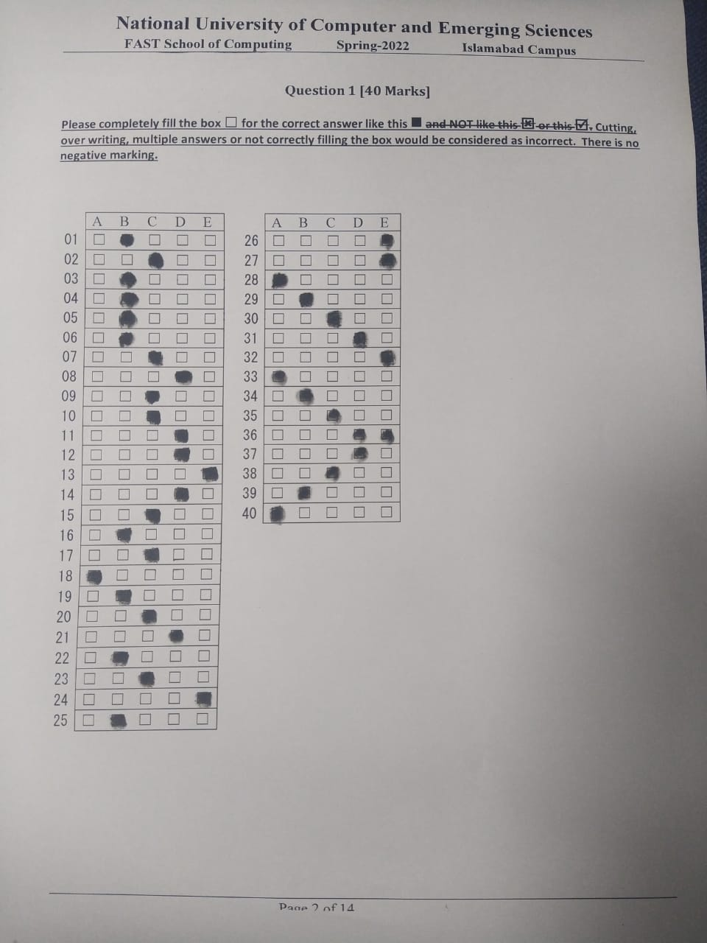
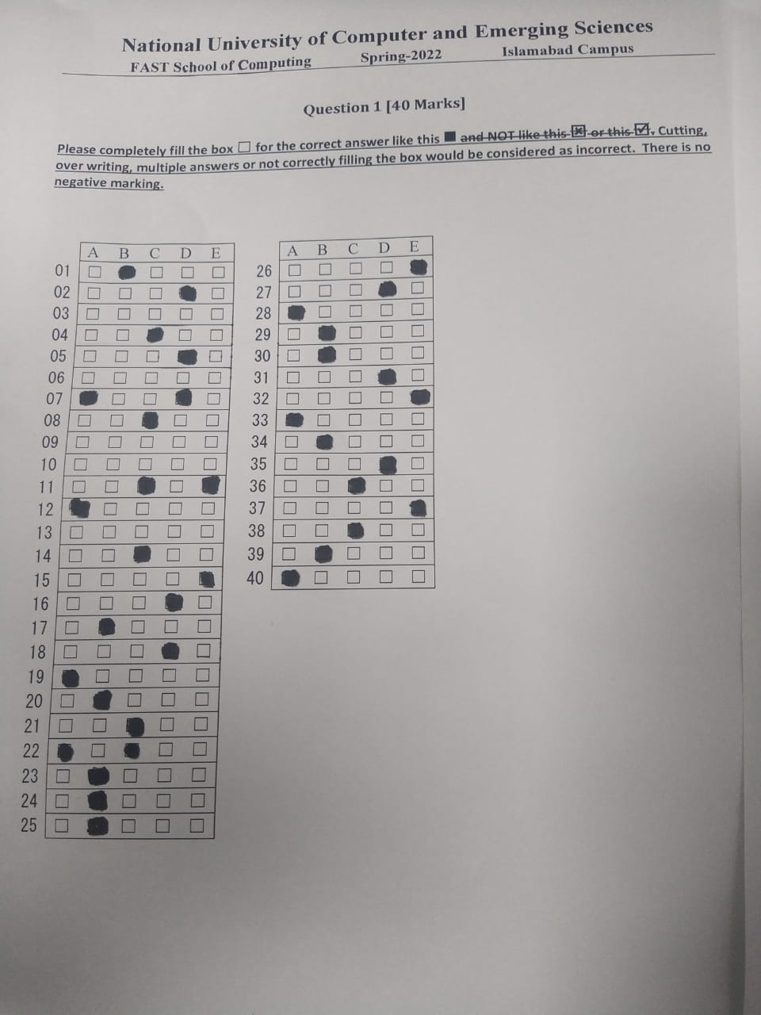
Dataset
The images are taken from the university question paper

Slide 6
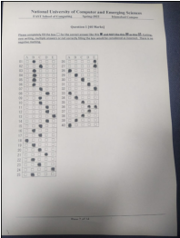
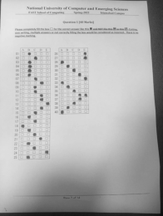
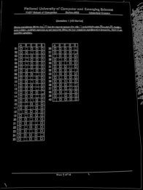
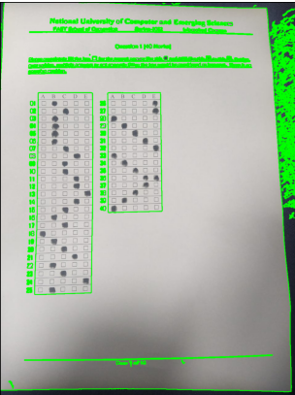
Implementation
Original Image
Grayscale Conversion
Canny edge detection
Image Contours

Slide 7
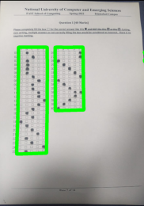
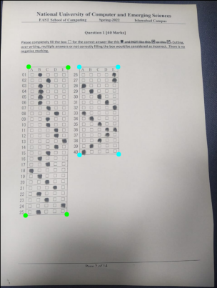
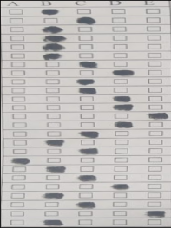
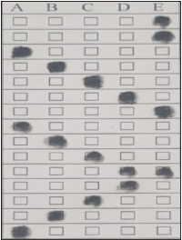
Implementation (Continued…)
Largest and 2nd largest Rectangle Contour
Boundary points of both Contours
Warping Perspective for each pane

Slide 8
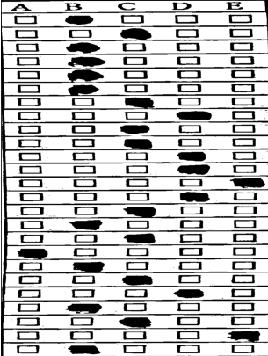
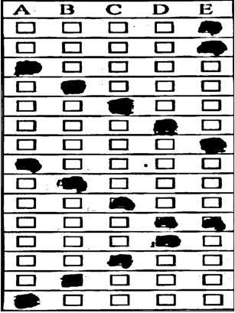
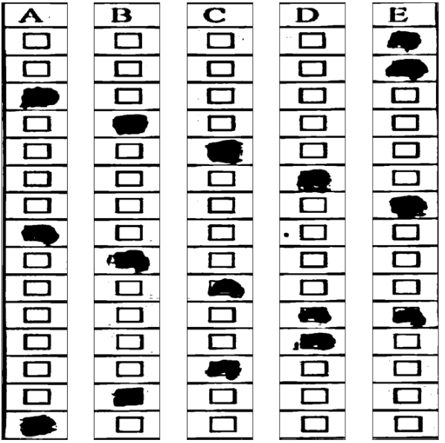




Implementation (Continued…)
Local Adaptive Gaussian Thresholding
Vertical split
Horizontal split
If num of black pixels is greater than threshold T, box is selected

